Slide 1
Employers Page and Job Posting
Overview
Our current website allows job seekers to search for jobs. To create an account, job seekers enter name, email, and password. Their sign up data is saved in MongoDB. In this SOW, you will add new features to allow employers to post jobs on the site. We also want any account users can search for jobs and post jobs using the same account.
To see existing website visit: https://138.197.90.207.
General Requirements for this SOW:
Freelancer shall use responsive design, meaning the site shall work well on desktop (all major browsers) and on all hand held devices
Freelancer shall be responsible for asking any questions that they don’t understand from the mockups and requirements
Freelancer must design the UI and the features flawlessly. i.e., Freelancer must use consistent font sizes, text colors, consistent empty spaces between texts, perfect alignment of information on desktops and mobiles and for all the pages. Owner will report as bug if the UI is not perfect. All features must work consistently and robustly.
Freelancer shall be responsible for fixing any issues that freelancer inadvertently breaks or causes to the existing features and site. Note: I have a duplicated server to verify the features before and after development in case this happens.
All forms and fields must be checked for correct entries and error messages must be generated if it happens. Freelancer shall use the same Keenthemes, which has all responsive UI, forms and fields checking, and hundreds of UI features, icons, pop up messages that freelancer can use for UI to save time (already installed on the server). It is okay to use your own themes if you don’t find it in keenthemes or you think it is better than keenthemes. http://keenthemes.com/preview/metronic/theme/admin_1/ui_icons.html
Freelancer shall design exactly as described in the mock up. Note: However, the mockup cannot guarantee consistency for alignment, color use, or consistency of size for boxes and texts due to powerpoint limitation. Also the mockup does not include all error necessary error messages.
Owner shall declare a sprint’s completion when every feature, buttons, links, content, and requirements are operated fully in both front end, backend, and in the database as described in the mockup and in this SOW.
Freelancer shall use following technology: MongoDB, Express, Angularjs, Nodejs.
Freelancer shall use existing code if available
Freelancer shall deploy finished code on Dev’s server and deploy to Production server when the Sprint is complete
Freelancer shall check in, merge new code with existing code in Bitbucket and deploy final code to Dev server before working on the next sprint.
Freelancer shall be responsible for fixing its own bugs found in Dev server or in Production system up to 3 months even after Freelancer has ended working for Owner. When Freelancer is still working for Owner, Freelancer shall be responsible for fixing its own bugs without limitation on the age of the bug.
Freelancer shall use round corner for all the buttons
All fields in the forms are required unless they show Optional
Freelancer shall send emails to the employer when:
The employer’s job listing plan have expired
The employer made a payment
An applicant submits an application (and we need to notify the employer)
Note: current website supports sending email. Owner will provide html templates for each of those emails.
Freelancer shall provide JSON request and response for employer’s data
Freelancer shall refund the cost of any functionality that was included in the SOW that Freelancer cannot deliver
Freelancer shall provide pop up confirmation message after completion of an action such as deletion, save, sent completed, etc.
A sprint is complete when all items in this requirements are met and there are no open reported defects.

Slide 2
Sprint 100: Build UI page for Employer
Slide 3: Add new selection to existing top bar
Add to top bar: “Employers”, and the dropdown list. All items on the dropdown shall work by the end of sprint 101 (except for Create Brand Page)
Sign up, Sign In, and Foot bar menu are currently working so they should continue to work. After Sign in or sign up, the user should stay on the same page.
Slide 4: Create employer’s overview page
This page is pretty much a static page. Freelancer should design the UI as shown in the mockup using sample data. Owner will replace the texts, price, and photos in the code later. Please to put the price inside a config file rather than hard coded in the code.
The URL for this page should be http://fillintech.com/employer/overview
Items that don’t work in Sprint 100 but will work in sprint 101:
Post Jobs For Free button
Create Brand Page button
Get Started button

Slide 3


Jobs
Apply For Me
Employers
Free Job Post
Sign In
Sign Up
If you click on Employers only then you will open Overview page or you can click on Overview in the dropdown. Click other items on the dropdown will open other pages.
Overview
Post a Job
Job Posting Plan
Create Branding Page
Click to open page 6
Open similar to page without the progress bar

Slide 4
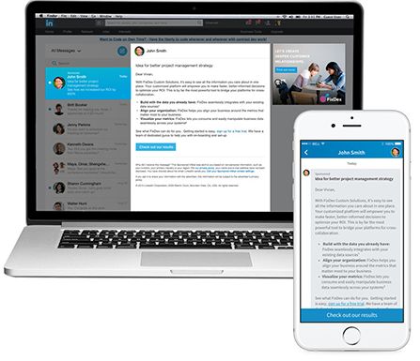
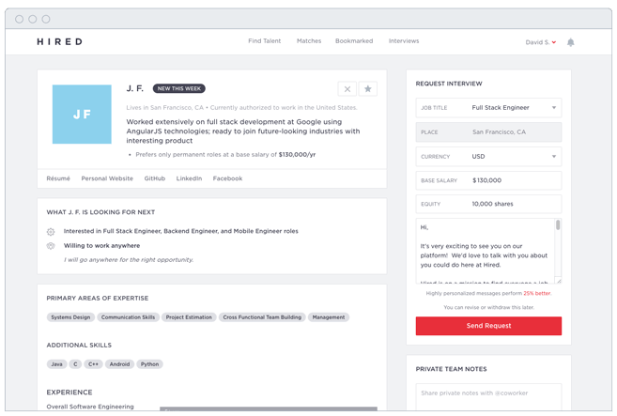
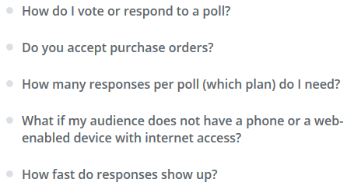

For Employers
Overview
Post a Job
Create Brand Page
Contact Us
Sign In
Sign Up
click on logo to go back to landing page
Open slide 6
Open http://fillintech.com/contactUs
Accelerate your hiring
in 2017
Are you happy with your hiring today?
Our new approach to attract candidates is affordable, fast and easy.
Try our 30 days risk-free jobs posting that works.
Open slide 6. If user has not signed in then open the page for Sign in, which already exist today. After sign in open page 6.
Post Jobs for Free
Easy and Affordable
Solutions
Manage, request for interview, and track
candidates with ease
Grab job seekers attention
with photos and videos
Option to show your photos
and videos next to your jobs ads
Option to use questions to filter
unqualified candidates
Create questions that candidates must
fill out Before submitting the application
Option to make your jobs
listing go viral
Signing bonus and referral fees
are available options for you to use
Promote Your Brand
Name for Free
70% of candidates would like to know
who you are before applying.
Best matched
Candidates
Receive daily best-matched candidates
to reduce your search time
Job Posting Plan
$0
$100/month
Owner will replace with price and text in code
Free Jobs Posting
Premium Jobs Listing
30 days jobs post
5 jobs
All features included
No end date – Cancel any time
50 jobs per month
All features included
Click buttons will open slide 6
GET STARTED
GET STARTED
Use: http://keenthemes.com/preview/metronic/theme/admin_1/page_general_faq.html which allows you to expand and collapse the question. Should put sample questions so Owner can replace them in the file later.
Frequently Asked Questions
Boost your hiring and grow your staff today
Promote your company and drive awareness
Click button will open slide 6
Try Free Post Job
Create Brand Page
Take code from current website
Notes:
https://www.ziprecruiter.com/pricing
Features: customer support, Unlimited candidates, candidate screening questions, mobile device support, social network integration, new candidate alerts, resume database alerts

Slide 5
Sprint 101: Post Jobs Page
General Info:
Everything displayed in these mockup page shall work fully (including all the buttons in Sprint 100 except for Create Brand page)
The url for page 6-9 shall be: http://fillintech.com/employer/post-a-job
If the employers exit the form, they should be able to resume to the page they had completed before when they log in again
- In mongoDB, you need to add a BAID to the account. BAID is Business Account ID to identify that the account has jobs posted by business/employers. Jobs Details information from this employer can be saved in other mongoDB. Let’s start this BAID at 10000. Some other important information mentioned here as a reminder:
Free trial: need to know if a plan is a free trial or a payment plan
Price plan: for example $0 or $100
Plan duration: 30 (30 days? Or no end date)
Payment date: may 8 2017 (date when user paid)
Payment status: Pass or Fail (was the payment pass?)
Listing start date: may 8, 207 (same date as payment date if payment passed)
Listing end date: June 28, 2017 (end date from plan duration or no end date)
Slide 6: Create Account Info
The page is self-explanatory
Employer only needs to fill out this page one time only.
Slide 7: About the job
The page is self-explanatory
Shall organize data for quick responses when it is requested (via JSON request /response)
Slide 8: About Company
Everything on this page should work fully.
The page is self-explanatory
Slide 9: Job application
Everything on this page should work fully.
The page is self-explanatory
Slide 10: Payment page
Everything describes on this page should work fully
Our current website is supporting credit card and paypal already. This UI is different but you should use the same code for interfacing with the payment system.
Send a confirmation email to the employer after a payment is made. I will provide you the html template. Note: Our current website is supporting email sending already.
The URL for this page shall be: http://fillintech.com/employer/job-posting-plan/

Slide 6
For Employers
Overview
Post a Job
Create Brand Page
Contact Us
Sign In
Sign Up
Account
About the Job
About Company
Application
Post Job
Account Information
This is private account information. Only you can see this information.
Your company name
Your name
Dropdown list:
HR / Company Recruiter
Business Owner
VP / Director / Department Manager
Executive Level
Recruiting / Staffing Firm
Other
Your title
Must check for valid entry for phone number, email address, and password entry. Code already available on current website.
This email address is not the same as the login email address.
Your phone number
123
Incorrect phone number. Please re-enter.
Your email address
By clicking Get Started, you agree to the Fillintech Pages Terms.
Get Started
Click to open a page http://fillintech.com/docs/business-page-terms
You create a page will sample text so Owner can replace it later
Button color is different when the button is not ready to click.
Click will go to next page.

Slide 7
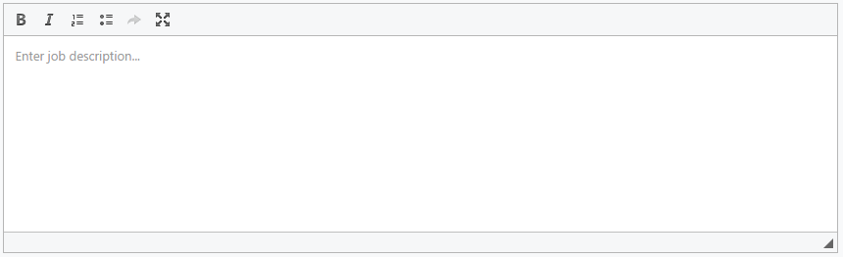
For Employers
Overview
Post a Job
Create Brand Page
Contact Us
Sign In
Sign Up
Account
About the Job
About Company
Application
Post Job
Tell us about the job
Provide the job description that the job seekers will see. Please describe in detail.
The box should be highlighted when selected
Job title and Job Location is available for autocomplete (see website)
Job Title
Marketing
Job Location
City, State, or Zip code
Job Category
Dropdown list is available under job functions in current website
Select category
Dropdown list:
Full Time
Part Time
Per Hour
Contractor
Temporary
Intern
Seasonal
Other
Employment Type (Optional)
Select type
Job Description
You may choose to edit using the template below or remove the content create your own description.
Choose a simple editor like this
We are looking for …
Responsibilities:
Enter the first job responsibility here…
Enter the second job responsibility here…
Etc.
Qualifications:
Enter required experience, if needed
Enter skills, if needed
Enter education, if needed
Etc.
Pre fill with some data where employer can overwrite it.
Show error message when it happens
Must be least 50 characters.
Dropdown list:
Per year
Per month
Per week
Per day
Per hour
Salary Range (Optional)
From
$
to
$
per year
Benefits Optional)
Medical Insurance
Dental Insurance
Vision Insurance
Life Insurance
401K
No benefits
Others (Optional)
Show box to enter amount if user selects the option.
Provide Signing Bonus. What’s this? Enter bonus amount:
$
Provide Employee Referral Fee What’s this? Enter Referral amount:
$
This job allows telecommuting
Pop up a sample help message. Owner will replace real text later.
Continue

Slide 8
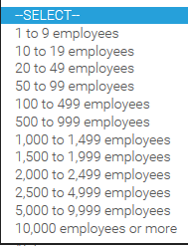
For Employers
Overview
Post a Job
Create Brand Page
Contact Us
Sign In
Sign Up
Account
About Job
About Company
Application
Post Job
Tel us about your company
Provide information about your company. Your street address will not be visible by job seekers but all other information will be displayed.
Hiring Company Name
Prefill with company name on slide 6
Alibaba
Company Industry
Industry list is available in current website
Company Size
Use drop down data
Company Street Address
(Street address will not be visible to job seekers)
Zip Code
City
State
list is available in current website
Company Description (Optional)
Describe your company…
Expand to larger box if needed
Company URL (Optional)
If you use keenthemes installed on the website then all checking is available
Enter URL here…
Want to upload your company’s photo or video? (Optional)
Your photo or video will be displayed next to the job ads. Have a photo/video will make your job ads more interesting. Accept one photo up to 5MB and one video up to 60 seconds long. See Guidelines.
Upload
Upload code is available in our current website
Back
Continue
Preview
Open Preview on another browser page

Slide 9
For Employers
Overview
Post a Job
Create Brand Page
Contact Us
Sign In
Sign Up
Account
About Job
About Company
Application
Post Job
Tell us about the job application
Let us know what you would like to do with the candidate’s applications.
Do you require the candidate to fill out the job application on your website? (Optional)
If Yes, enter your company’s job site address below.
e.g.: http://yourcompany.com/jobs/...
If selected Yes, show box to enter URL. Enter URL is required.
Would you like Fillintech to send you the job applications by email? (Optional)
If Yes, enter your email address below.
Enter your email address here…
+ Add more email
Would you like to ask specific questions to the candidate? (Optional)
If Yes, enter your question(s) below. You may create up to 10 Yes and No questions.
Expand the text box if more texts are entered. 10 min, 50 chars max.
Question 1 (Candidates can only answer with a YES or NO):
Can you drive a car?
Question 2 (Candidates can only answer with a YES or NO):
Enter your question here…
+ Add Question
What would you like to do with the answers from your candidates?
Only show this question if the employer created the question above
Notify me of all candidates who answer either YES or NO to the questions above
Notify me only candidates who answer YES to the above questions
Notify me only candidates who answer NO to the above questions
Do you require a resume?
Resume – Candidate must submit a resume with the application
No Resume – A resume is not required
Back
Continue
Preview
Open Preview on another browser page

Slide 10
For Employers
Overview
Post a Job
Create Brand Page
Contact Us
Sign In
Sign Up
Account
About Job
About Company
Application
Post Job
Post a Job
Choose a job plan that that fit your hiring needs.
$0
$99/month
These are sample text. Owner will replace real amount and text later.
Free Jobs Posting
Premium Jobs Posting
List 5 jobs at a time
Receive unlimited job application
Attach photo/video with each job
Find unlimited resumes
Contact candidate - $0.99/candidate
List 30 jobs at a time
Receive unlimited job application
Attach photo/video with each job
Find unlimited resumes
Contact unlimited candidate
SELECT
SELECT
Click Select will open a similar box in orange color.
Your Free Jobs Posting plan will end on Monday, June 2017. You will not be charged during this period. Only $100/month will be billed after the plan has ended and you can cancel at any time.
Why do I need to enter credit card? We only need to verify that you are a real person that has
legitimate job openings.
Enter your credit card to start posting jobs
Credit Card number
Card number
Our current website already taking payment. So you can copy the code.
Name on Card
Name on card
Month
Year
Security Code
Month
Year
Zip Code
Display this if $0 is selected.
Replace this message with the following if $100 was selected:
I understand I will be billed $100.00 monthly. The monthly plan will renew if you don’t cancel more than 24 hours before your renewal date.
I understand I will be billed $100.00 monthly after the Free Jobs Posting plan ends
and I can cancel at any time.
Post My Job Now

